Slide 1
Ggplot2 and interactive graphics with R
Christophe Ladroue
SECTION 08
VIDEO 02
Building time series plot
www.PacktPub.com

Slide 2
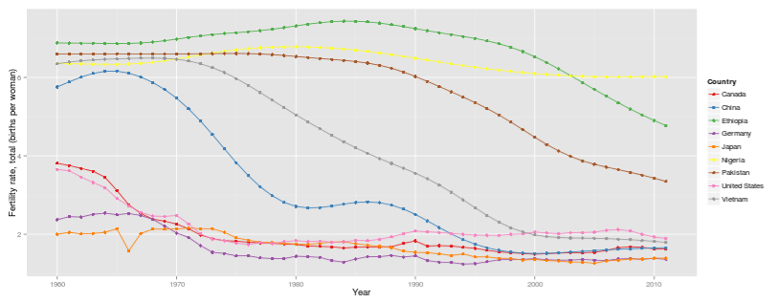
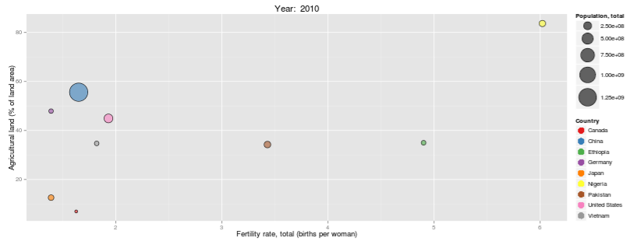
In this video we took a look at
how to build a Shiny app with a time series plot.
how to easily map obscure column names to human-readable titles and display them to the user.
how to plot on a logarithmic scale.
Next: Making a bubble chart

Slide 3
In this section we’re going to take a look at
Designing the dashboard
Building the time series plot
Making a bubble chart in ggplot2
Making conditional panels
Building our dashboard

